Slide 1

Learning Reimagined
System for Post Covid School - Group 1
Team : Prafull, Yashada, Namrata, Vaibhavi

Slide 2
Initial design brief
To study and understand the effects of forced online learning due to covid on the school students of
different age groups, regions and financial background.
System for Post Covid Schools - Group 1
01

Slide 3



1,00,78,708
89,88,595
The Current state of Government Schools
In year 2019, The state has
1,16,233 schools
Boys
28k
Government Schools
47k
Local Body, CG, Schools
Girls
System for Post Covid Schools - Group 1
Source: https://education.maharashtra.gov.in/edudashboard/
02

Slide 4
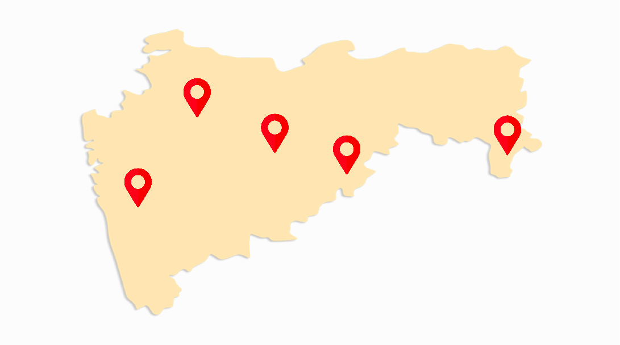
317
2,500
58,000
Most affected districts
No classrooms
Jalna
Only 1 classroom
Parbhani
Gadchiroli
Nanded
Pune
2-5 classrooms
System for Post Covid Schools - Group 1
Source: https://education.maharashtra.gov.in/edudashboard/
03

Slide 5



73,500
28,560
7,500
Digital Divide
At present, in gov schools the digital infrastructure is lacking as per student ratio
Computers
Laptops
Computers lab
System for Post Covid Schools - Group 1
Source: https://education.maharashtra.gov.in/edudashboard/
04

Slide 6
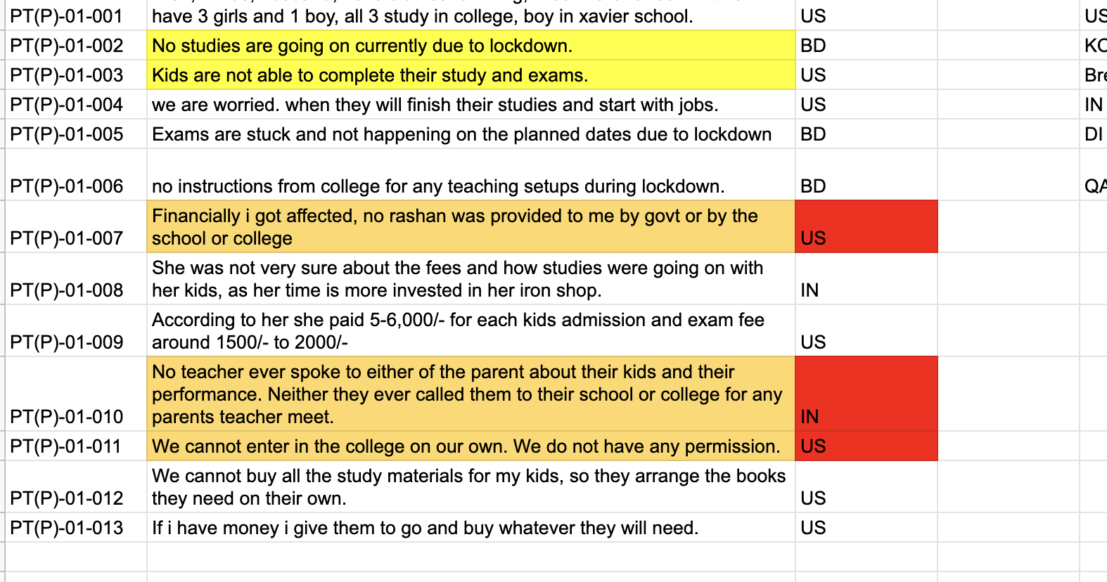
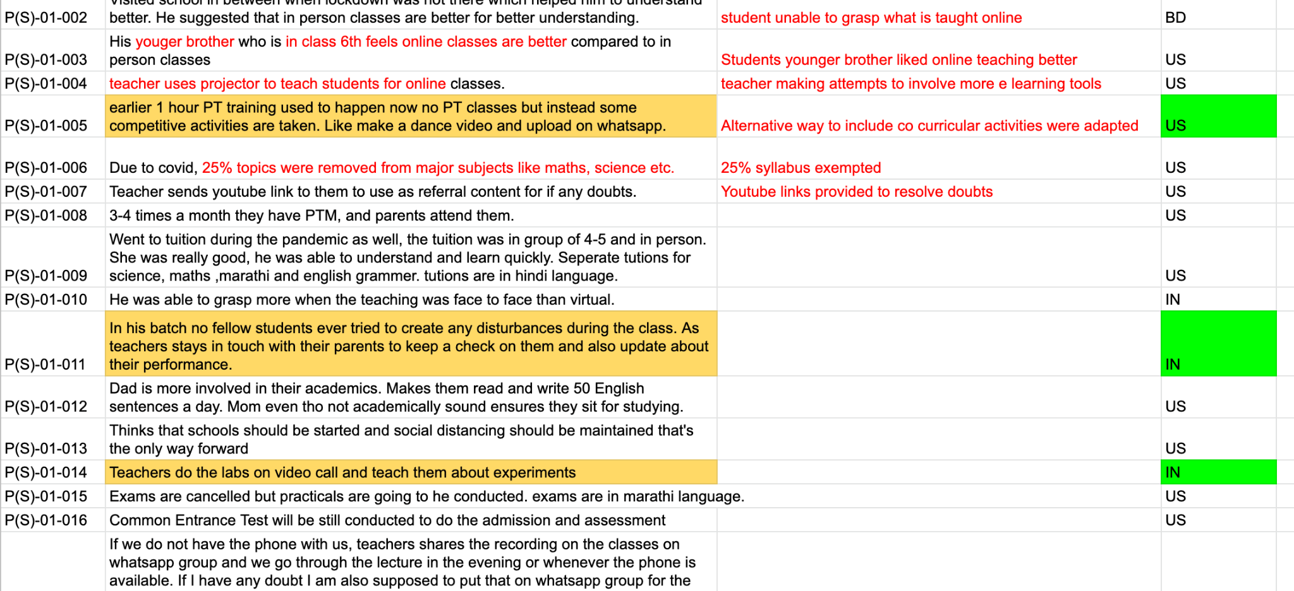
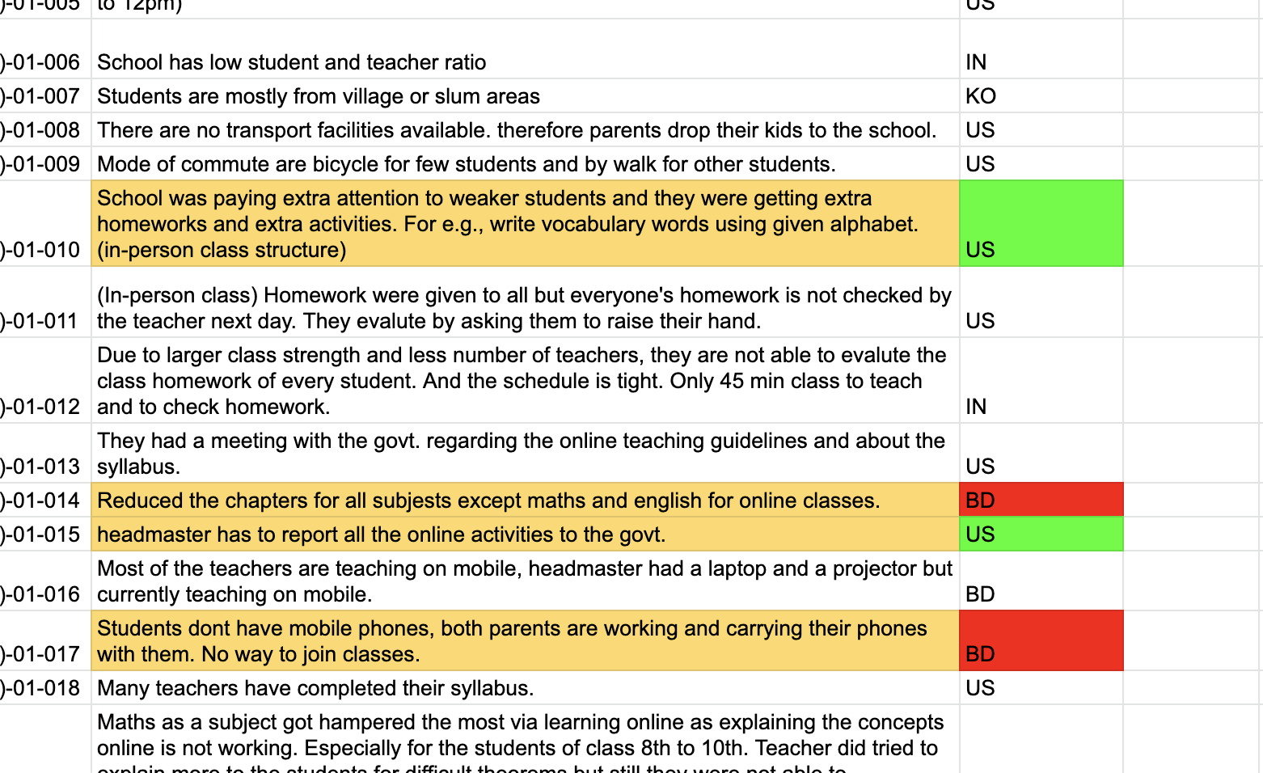
User interviews
Students
Teachers
Parents
Tuition teachers
03
02
02
02
System for Post Covid Schools - Group 1
05

Slide 7
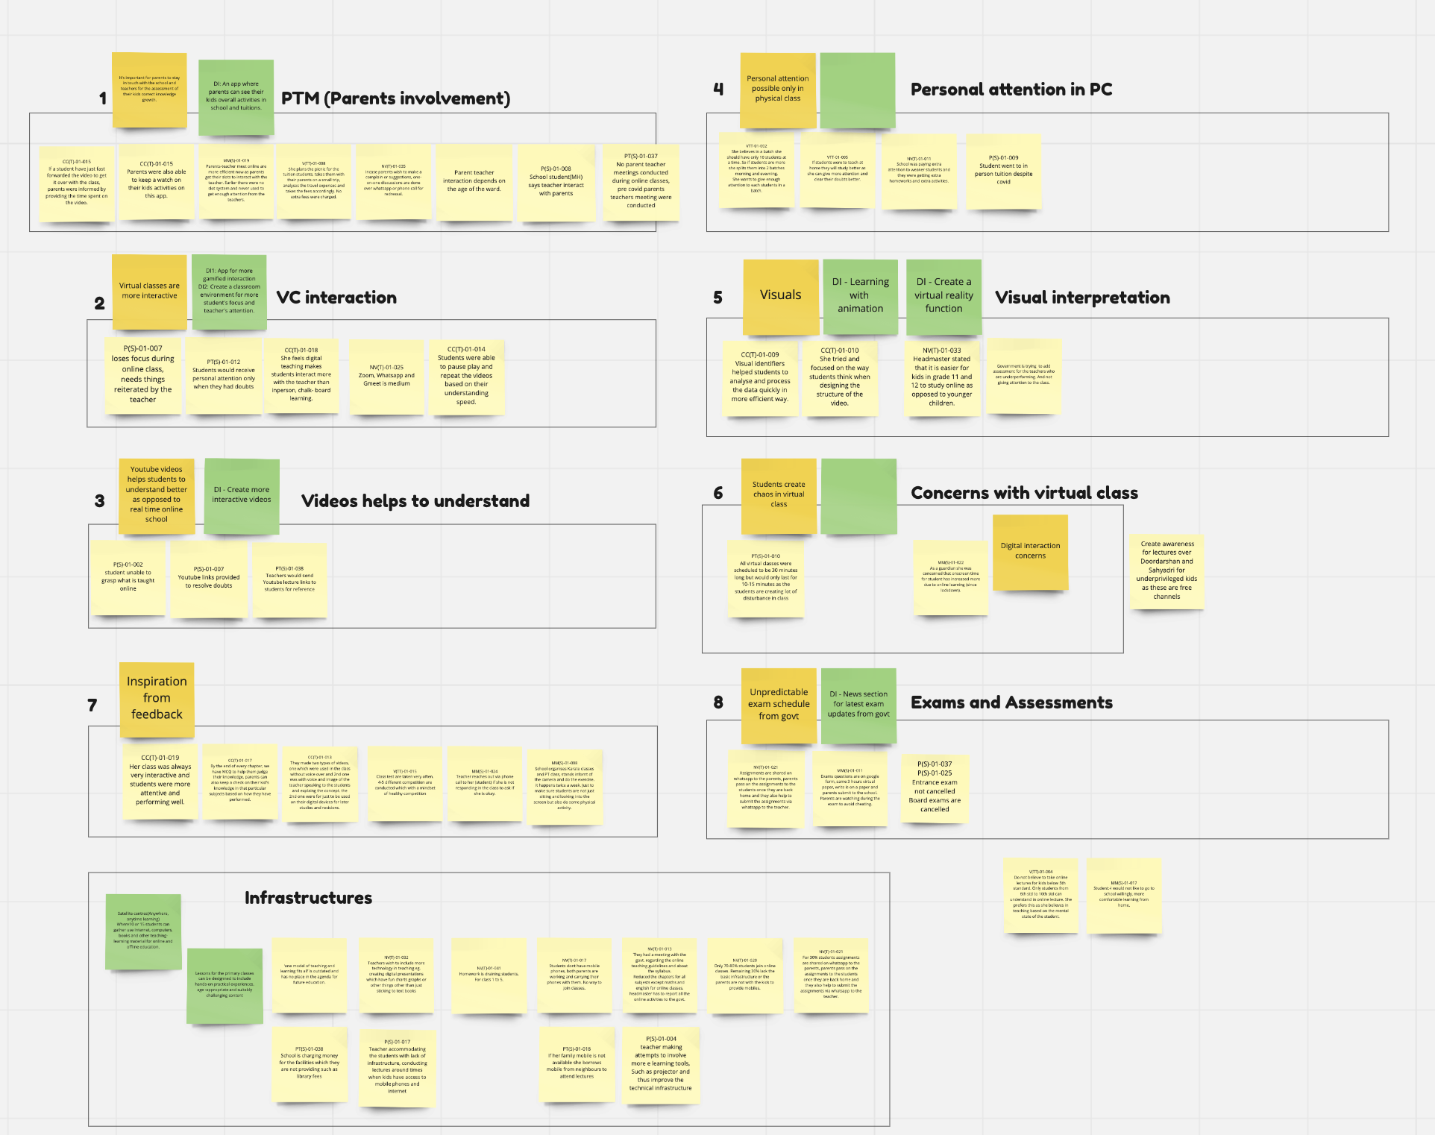
Affinity mapping
System for Post Covid Schools - Group 1
06

Slide 8
Findings from the affinity
No control over students in online class.
(fake accounts were created)
Technology restrictions.
(zoom free meeting last for 45 mins only)
Electricity disturbance. (uncertain power cut)
Dependencies on parent mobile to attend online lectures.
(only one device at home)
25% syllabus exempted.
Results into to careless attitude of students over studies.
(cheating in online exams made easy)
System for Post Covid Schools - Group 1
07

Slide 9
Goal
To encourage students to study with a disciplined manner even at home.
To make study available outside school.
Reduce infrastructure dependencies.
Help teachers and parents to stay more connected with students progress.
System for Post Covid Schools - Group 1
09

Slide 10

About
Born and raised in Nasik, wishes to do something to improve the education situation of her village. She is a school teacher by the morning and tuition teacher by the evening.
Goals
Democratize education
Ensure fees and poverty don't deprive kids of an opportunity at a better future
Create awareness around girl child education
Pain-point
Ever since covid, many of her students have dropped out of school due to lack of infrastructure such as phones, electricity etc
Many kids are unable to attend online school
Unable to teach children mathematics effectively
Meena ma'am
Science teacher
Age 34
Sayyad Pimpri, Nasik
System for Post Covid Schools - Group 1
10

Slide 11

ABOUT
Born and raised in Kolhapur, couldn't work post getting married. Is a very driven and ambitious person. She wants to see both her kids become IAS.
Goals
Be able to closely monitor kid's academics.
Be able to contact the teachers and other faculty from time to time.
Pain-point
Ever since covid the screen time for the kids has skyrocketed but Santosh doubts if they are really studying.
Not enough interaction with the teacher via parent-teacher meeting bothers her.
Feels online schooling has compromised academic integrity.
Santosh Sharma
Homemaker, Mom of two
Studied BSC Botany
Age 38
System for Post Covid Schools - Group 1
11

Slide 12
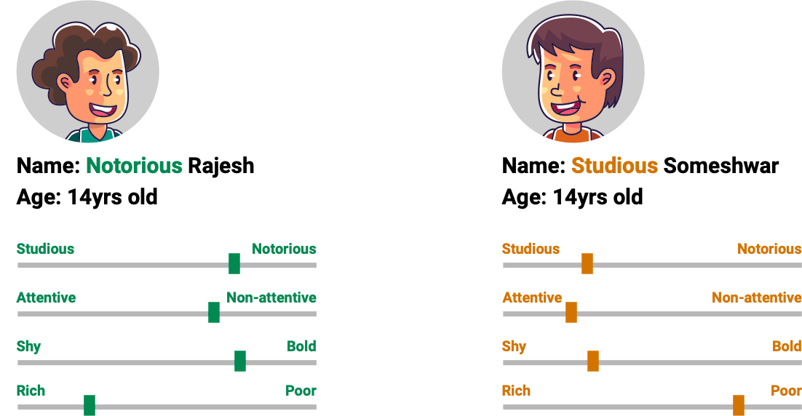
Personas
System for Post Covid Schools - Group 1
12

Slide 13
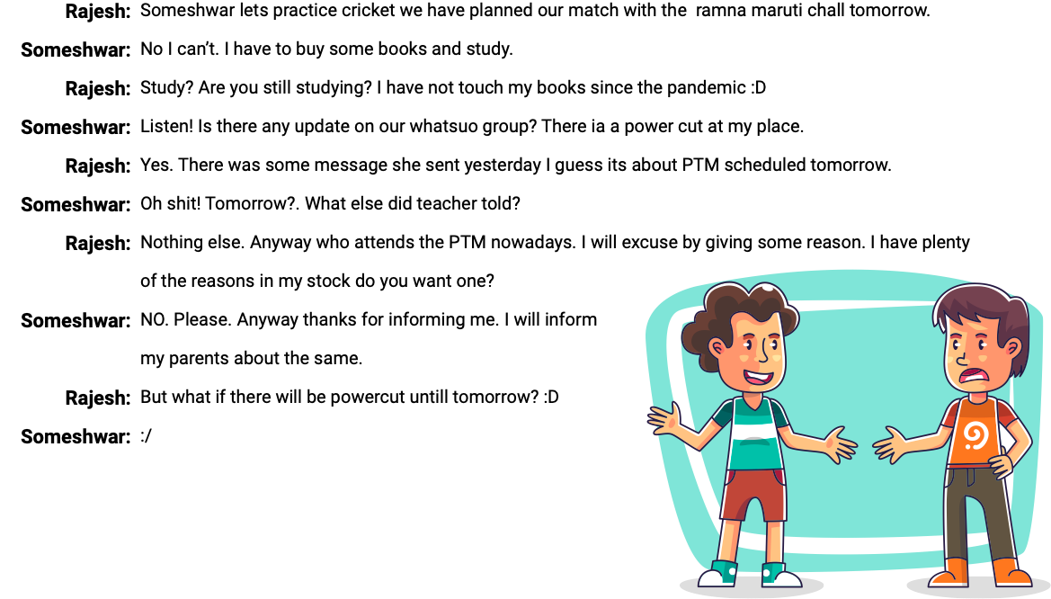
Before Scenario
System for Post Covid Schools - Group 1
13

Slide 14
Post Covid Learning System

Slide 15
Findings for post covid solution
Sanitation of classes, Isolation centers at schools, proper health checkups, providing safety material before academic year starts.
Ensure all children are covered for education in the next academic year.
Tools, tech and teachers biggest hopes to recover lost ground
Use hybrid school pattern where students can learn offline and online.
Collaboration with NGOs, private contributors and volunteers to building foundational skills.
System for Post Covid Schools - Group 1
14

Slide 16
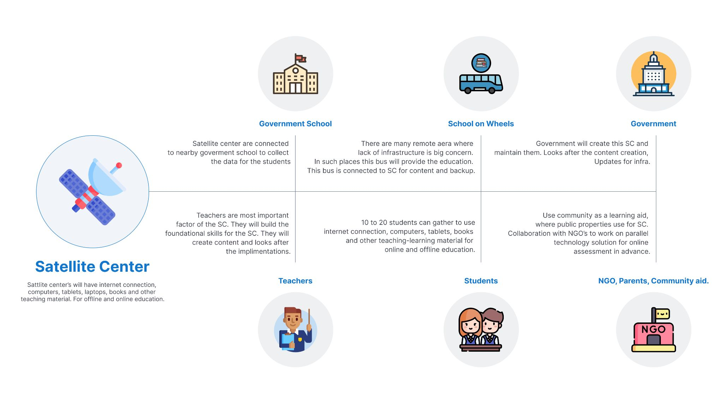
System for Post Covid Schools - Group 2
5
System for Post Covid Schools - Group 1

Slide 17
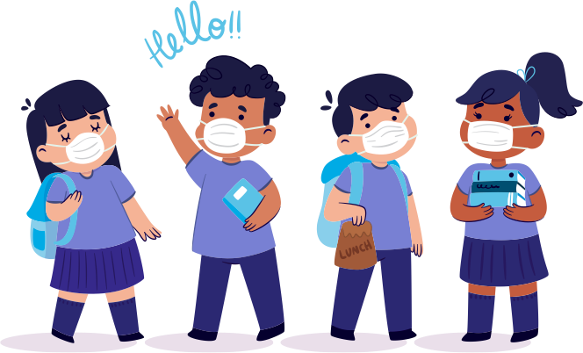
Focus
We have huge number of target audience so we have narrowed down our focus from 8th std to 10th std students.
System for Post Covid Schools - Group 1
08

Slide 18





Approach for different users.
Teachers
Parents
Students
Digi-Bag tablet app
Digi app
System for Post Covid Schools - Group 1

Slide 19
For parents and teachers
Prototype link:- https://xd.adobe.com/view/cbe1e8a5-eb6d-4f09-bb98-5659982e78ec-9eb2/
Teachers
Parents
Digi app
System for Post Covid Schools - Group 1

Slide 20
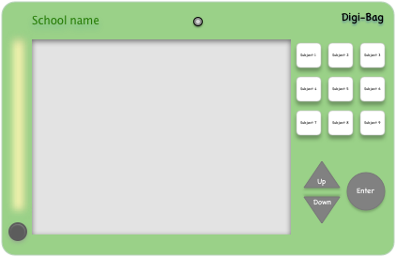
Digi-Bag tab
School name - name of the school printed.
Camera - switches on when you are attending class. No option to switch off.
All the subject listed here- Teachers will add the list of the subjects here, so that kids can select the subjects from here.
LED lights - to have enough light on the kids face while video classes.
Buttons to move - to move around to view all the chapters and to make selections.
LED light switch - to switch on/off the lights when needed.
System for Post Covid Schools - Group 1
16

Slide 21

Digi-Bag tab
Prototype link :- https://xd.adobe.com/view/fc78f306-1fb9-483c-af25-13d031ffedda-a92b/

Slide 22
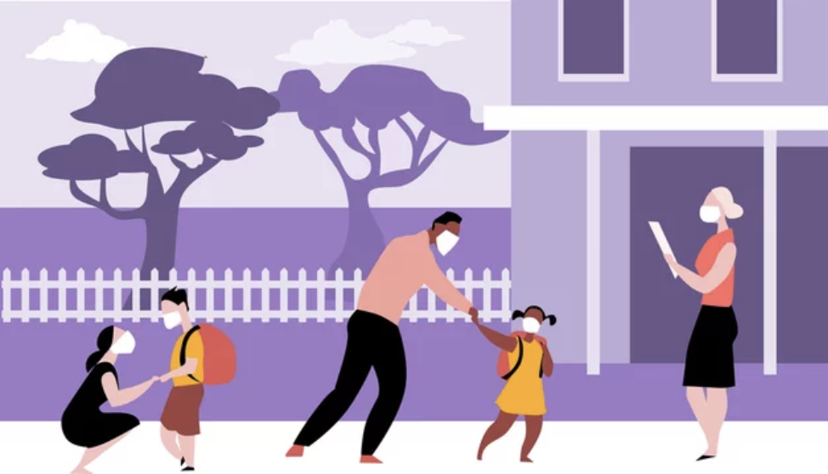
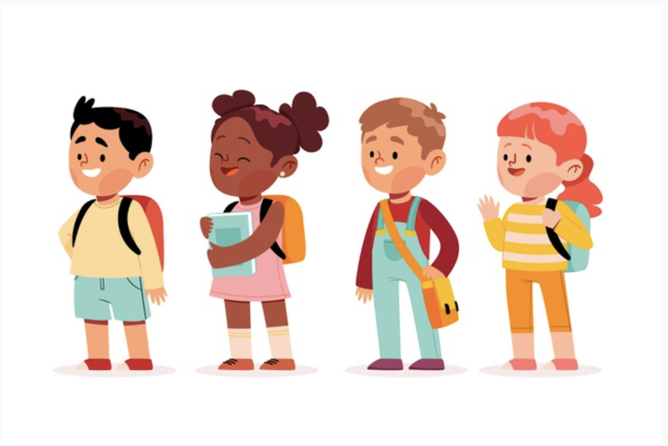
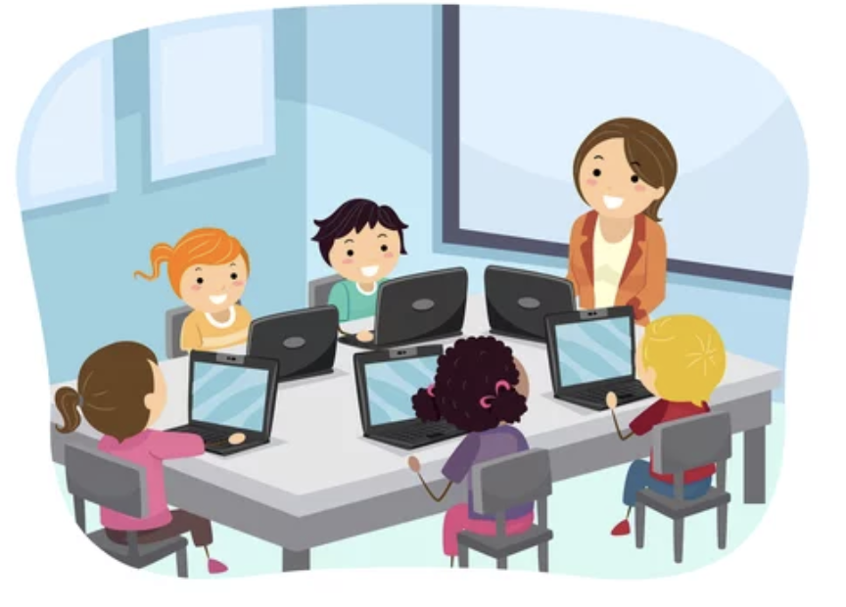


System of Digi-Bag
Back to school
Students are dropped to school or reaches school.
Basic sanitization process
Kids are sanitized before entering the class.
Introduction to new ways
Teacher introduce Digi-Bags to students.
Government centralised system
Digi-bag uploads or downloads the files/ tests in the center hub. Only teachers will have access to this.
Trial and error
Teacher asks all the students to try out the Classroom option in the class.
Keep it updated
Teachers has added all the courses and chapter for each subject in their digi-bag. Each grade has different colour device.
System for Post Covid Schools - Group 1

Slide 23
Stages of reimagined learning.
Stage 0
Stage 1
Stage 2
Stage 3
Change in the daily school system.
Starting with class 8th, 9th and 10th.
Get the feedback and inputs from all users.
Move to younger classes.
Introduce Hybrid learning to students.
Get the course installed in the tab.
Improvise the concerns
May need change in the device and move away from complete touch screen.
Getting teachers trained for Hybrid learning.
Introduce Digi app to parents
Launch again
Test and re-launch.
Setup needed for Hybrid schooling
Conduct a pilot version

Slide 24
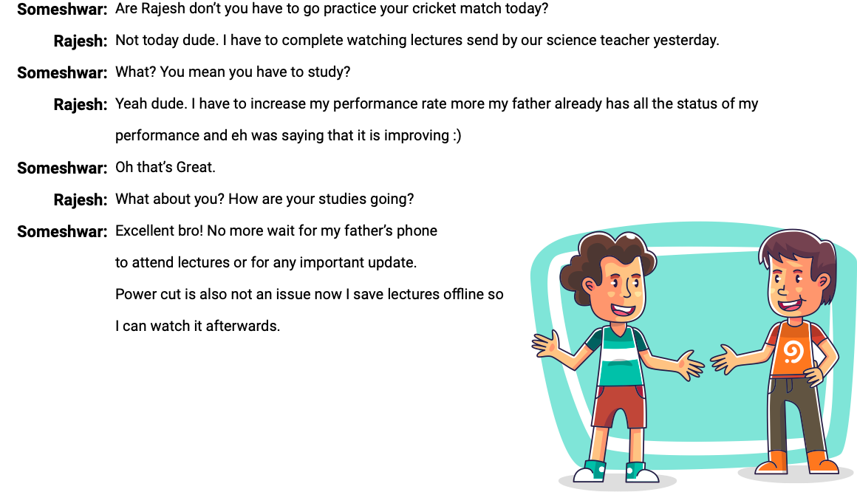
After Scenario
System for Post Covid Schools - Group 1
18

Slide 25
Maybe one day..

Slide 26
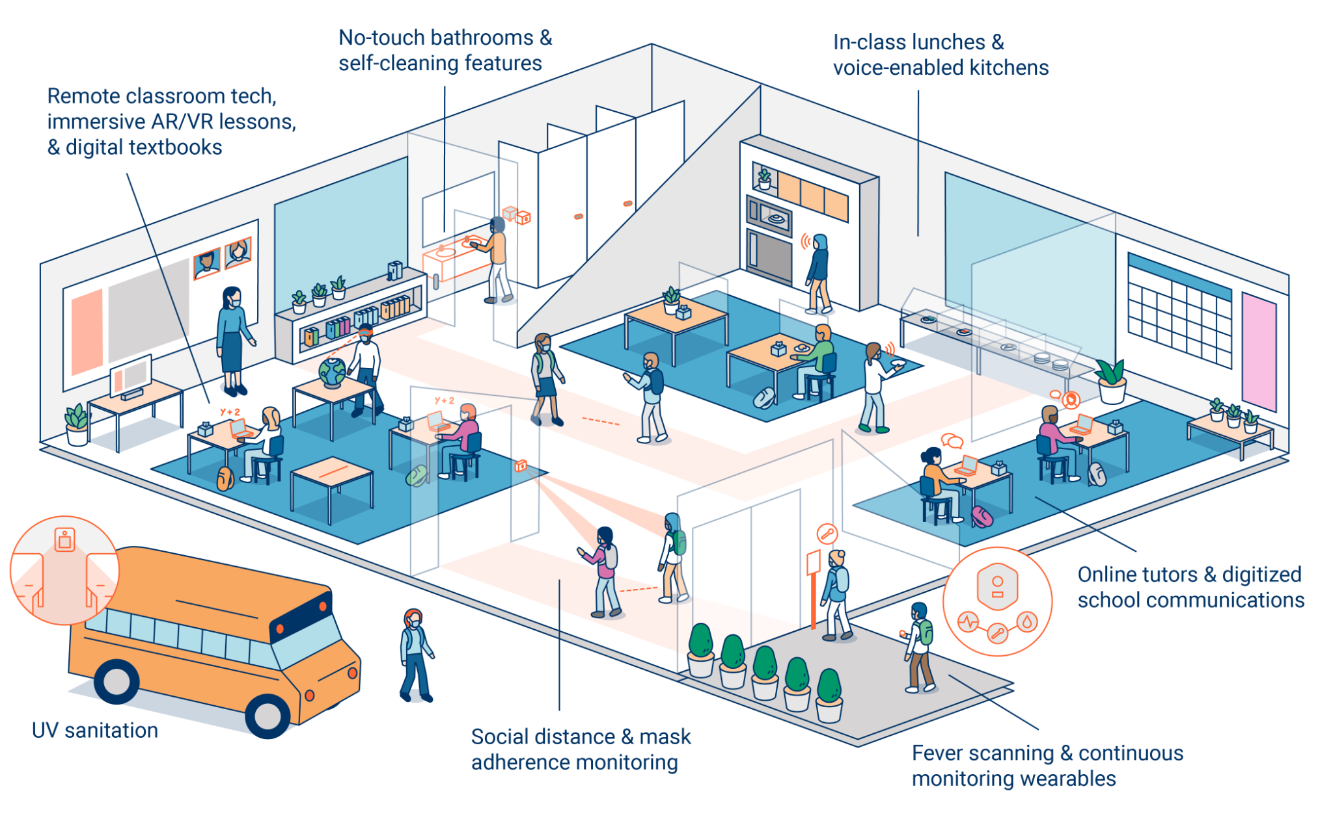

Slide 27
Thank you

Slide 28
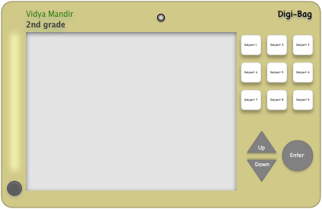
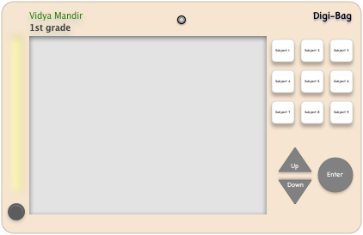
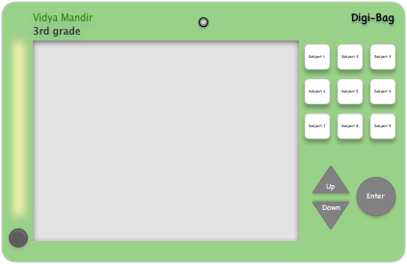
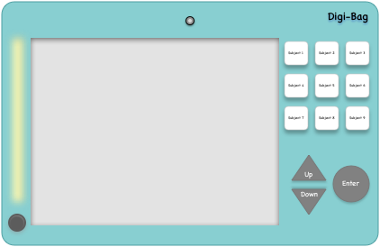
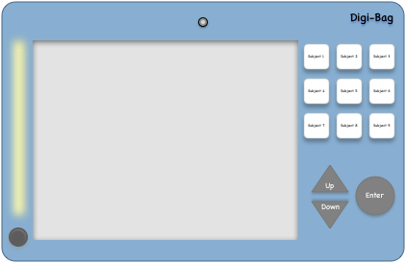
Digi-Bag
Colour code for each grade
Device must be created keeping kids in mind.
Subjects upfront.
Inbuilt camera and LED lights
No touch screen.
Audio capture option(Record your audio homeworks)
Inbuilt speaker.
Only teachers can add data in the devices.
Upload hubs ( with teacher)
Saves paper.
Comes with a stand.
Can be reused by next batch of students.
Eye protection guard.
Each subject button will have respective folder to store chapters.
Video chapters with animations to help kids with their visualization

Slide 29
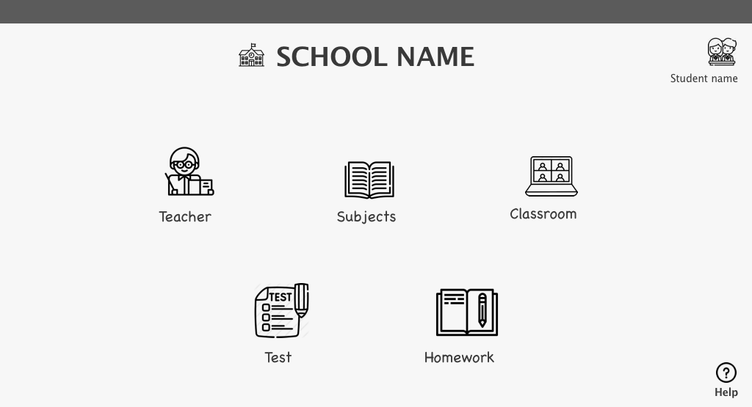
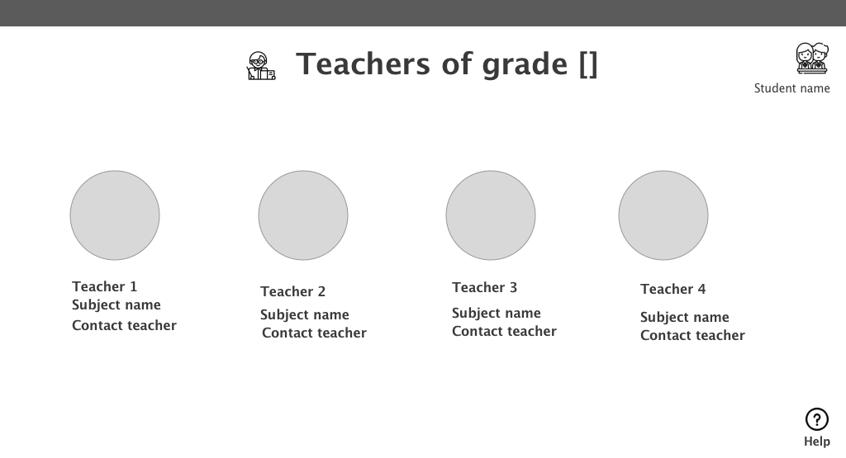
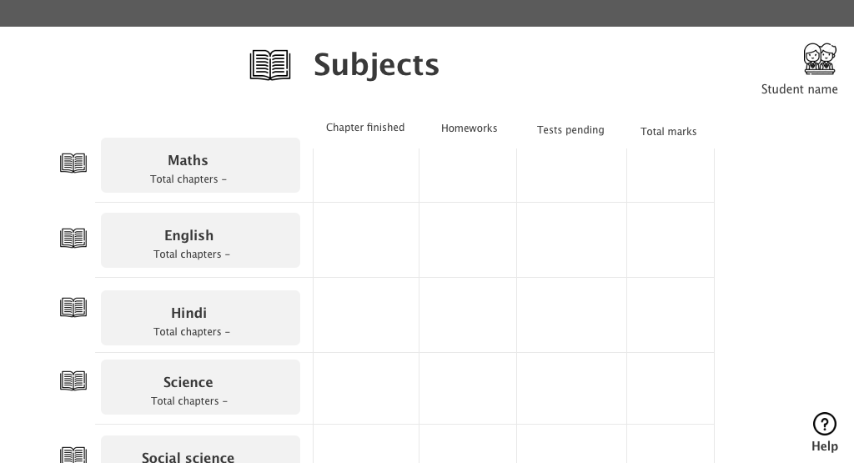
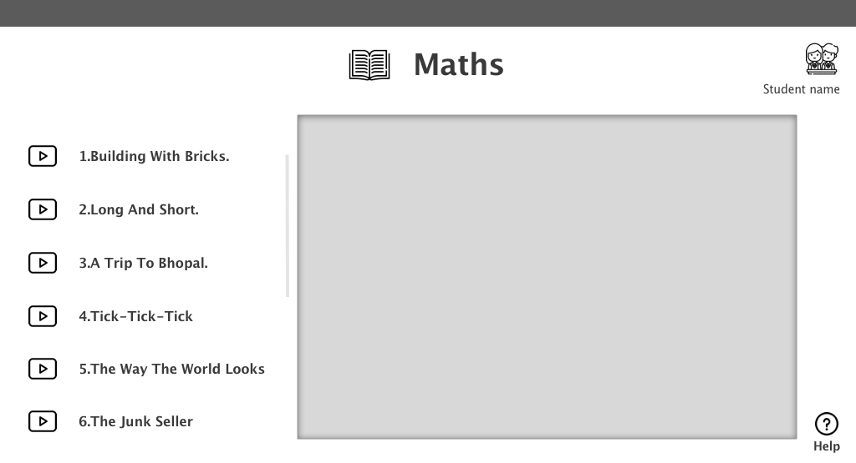
Wireframes for student’s devices
Landing page
Teacher page
Subjects page
Each subject page

Slide 30
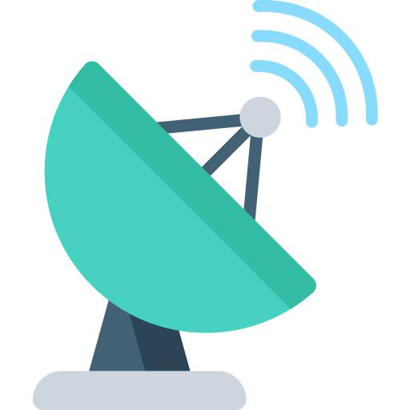
1.Satellite center for schools
Where 10 to 15 students can gather to use internet connection, computers, tablets, books and other teaching-learning material for online and offline education.
These centers can be connected to the nearby government schools.
Teachers training to equip them with the right tools for bridge courses.
Use Community as aid, where public properties, parks, buses can be used for learning to reduce the infra cost.
Collaboration with NGOs, private contributors and volunteers to building foundational skills.

Slide 31
If we provide all infrastructure and
create strategic plan will problem
get resolved?

Slide 32
Big No… Why...because
Culture eats strategy for breakfast.

Slide 33
How to change the culture..
Chaining the policy or adding extra funds will not change the culture. We need commitment from Policy makers, teachers and parents to bring the change we wish to see.
Currently there is wrong culture in public education, teachers lacks commitment towards jobs.
Policy makers unable to create positive ecosystem, no mechanism to evaluate the ides gets implemented at ground level.
Lack of motivation from parents towards education.
Teachers assessment and upskilling.

Slide 34
Behavioural strategy: Green path behaviour
Motivation, Ability, and Triggers
Green Path Behaviors imply a life change. The change can be big, like learning new technology. Or it can be small, like going to school on time. Either way, Green Path Behaviors have two challenges: commitment (agreeing to the change) and fulfillment (behaving in new ways).
Increase the number of triggers leading to the desirable behavior.
Boost motivation
Amplify motivation for doing the behavior with intrinsic and extrinsic motivators
Enhance ability by making the commitment act simple
Sequence of behaviors

